Slide 1
Rise Academy
First-Year Experience Program

Slide 2
Presentation Objectives
Define Rise Academy and Scholar Benefits
Explain Eligibility Criteria
Expand on Rise Program Content & Schedule
State the Rise Scholar Expectations
Share Rise Scholar Testimonial
Rise Academy Partners
Notes:
The student will earn 3 college credits before the fall semester even starts.
Students will get to know their professors and freshmen classmates.
Discover how different college majors lead to career paths and which is right for you.
Explore the Chicago State campus and student resources

Slide 3
What is Rise Academy?
Rise Academy is a full-tuition and fees scholarship program that provides financial, academic, and personal support for eligible first year students.
Rise Academy allows students to:
Test-drive a CSU course
Maximize college resources
Take a closer look into your career of choice
Establish relationships with faculty, staff, and peers
Notes:
The student will earn 3 college credits before the fall semester even starts.
Students will get to know their professors and freshmen classmates.
Discover how different college majors lead to career paths and which is right for you.
Explore the Chicago State campus and student resources

Slide 4
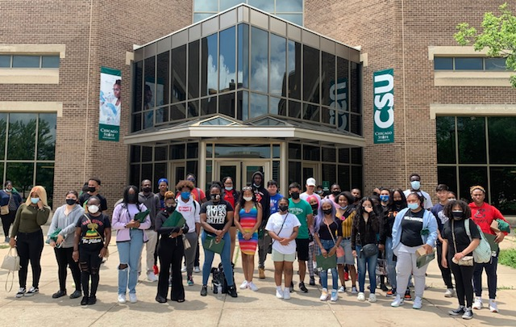
Essentially, the Rise Academy helps students build the necessary skills and social capital optimal for a successful first-year in college!

Slide 5
Rise Scholar Benefits
Tuition and fees for the first-year at CSU after applying all financial aid awards*
Free loan of a university laptop for all four undergraduate years
Textbook vouchers to eliminate and/or reduce the cost of required course materials
Advisors, workshops, & resources to guide & support your progress
(*) The Rise Scholarship is a tuition-only scholarship and does not cover room & board expenses. However, if a student qualifies for a Pell grant, those funds may be used to cover room & board expenses.

Slide 6
Eligibility
Summer Academy
First-year Freshmen (never attended college)
Complete CSU Application
Send Official Transcript from High School(s) to Registrar
Personal Essay
Counselor/Teacher Recommendation Form
Transfer Students (with less than 24 credits)
Complete CSU Application
Send College Transcripts to Registrar
Apply to CSU here:

Slide 7
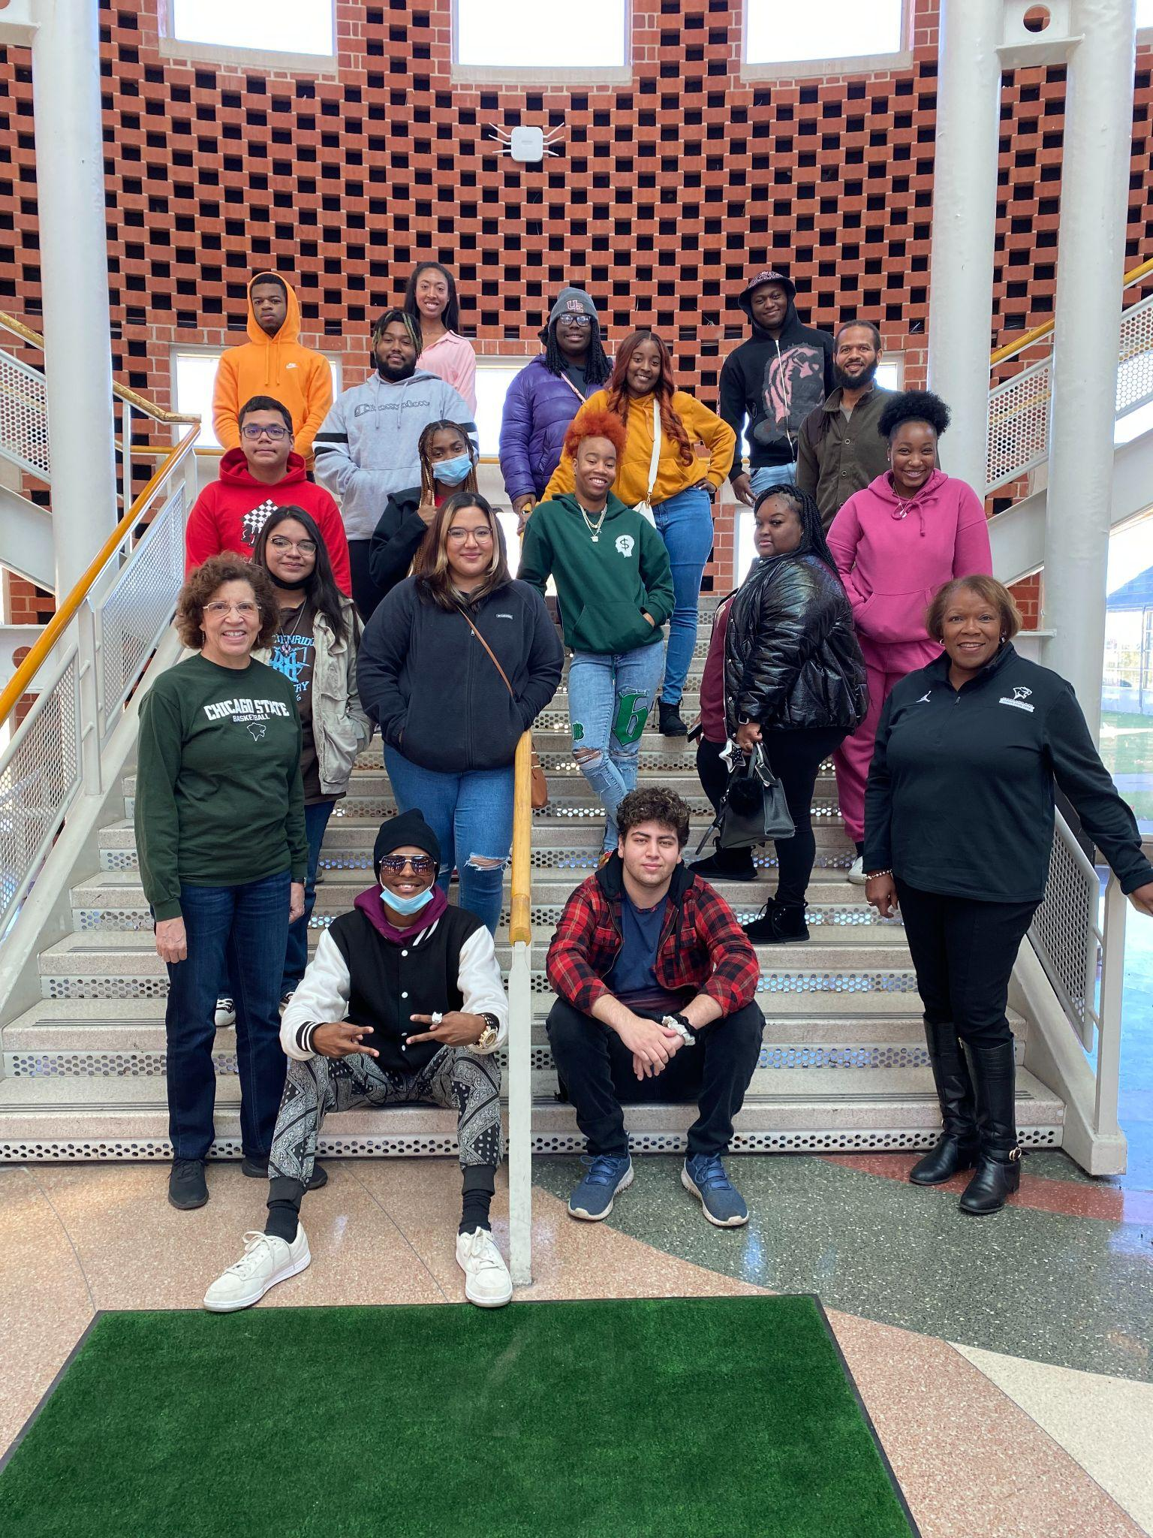
How Does Rise Academy Work?
Summer Academy
Rise Scholars are required to complete the 5- week Rise Academy Program.
After successfully completing this program, students will be eligible to enroll in full-time classes and continue to receive the Rise Scholarship for their first full year at CSU.

Slide 8
Rise Tuition-free Scholarship
Student attends assigned college course over 5 weeks
*Note: The Rise Scholarship is
NOT need-based.
If student passes their course & meets other program requirements, they will be eligible for the Rise Scholarship* for 2 semesters.
Student attends 3 workshops
Student attends weekly tutoring

Slide 9
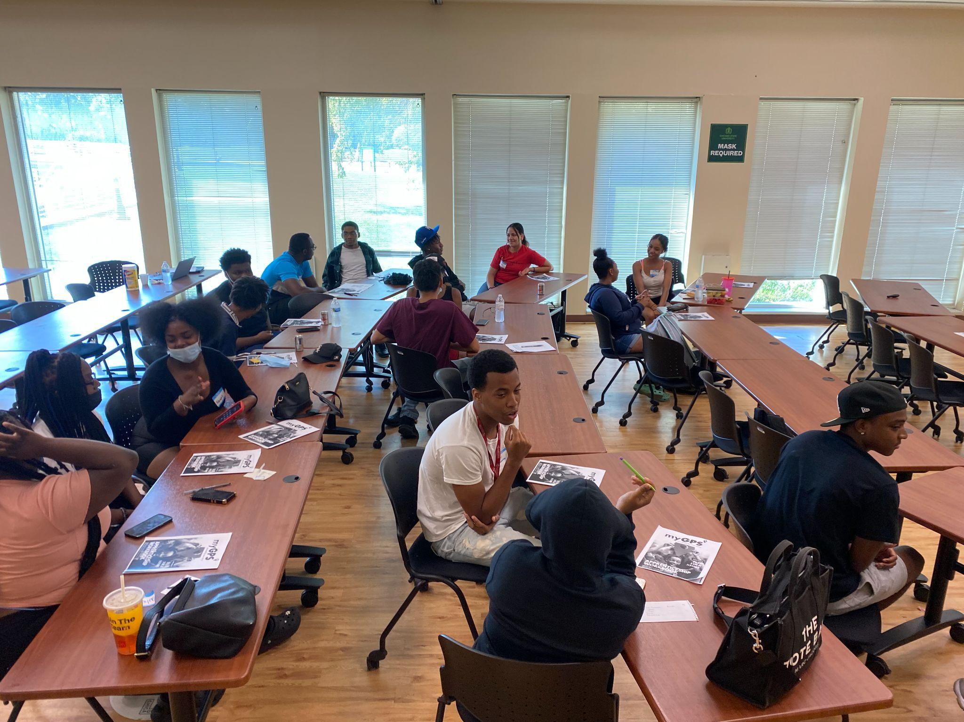
Rise Academy Content
Summer Academy
Five week, 3 credit hour course
Rise Workshops
Networking Events
Weekly Tutoring Sessions

Slide 10
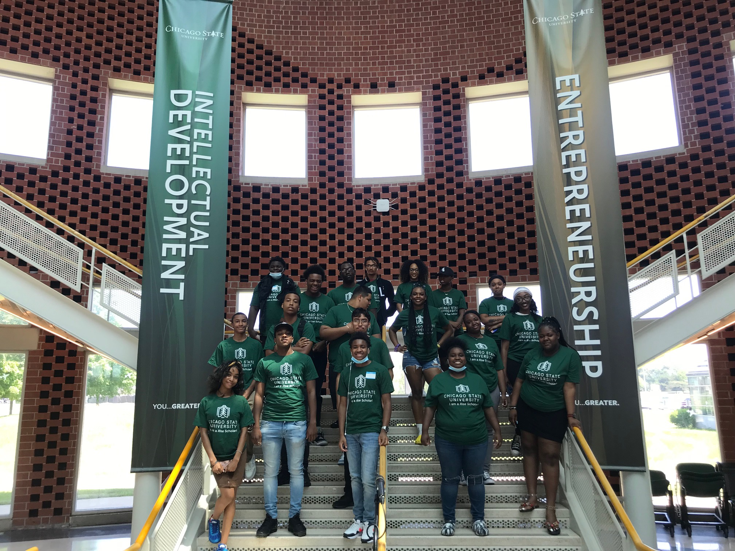
Rise Academy Course
Summer Academy
Possible courses include:
English 1230 – Writer’s Workshop I
English 1270 – English Composition I
Sociology 1250 – Diversity in Society
Art, Music & Speech Courses

Slide 11
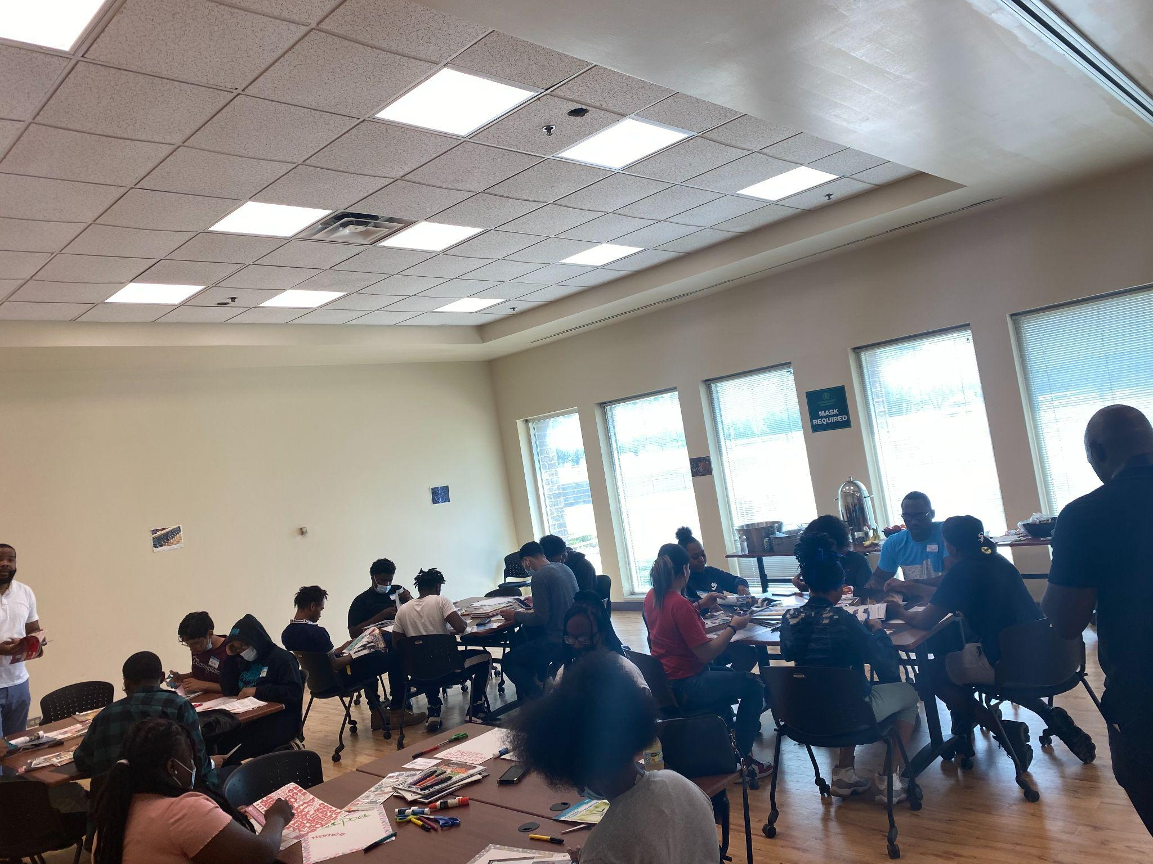
Workshop Topics
Self- Exploration
Social Capital
First Year Student Mental Health

Slide 12
Networking Events
Summer Academy
Chat and Chew with the CSU President and Provost
My GPS -The Purpose Gap
LinkedIn and Professional Headshots
Rise Outing

Slide 13
Sample Rise Academy Schedule June 20- July 21st
 | Monday | Tuesday | Wednesday | Thursday | Friday
8:00 am
9:00 am | Class
10:00 am
11:00 am |  |  |  |  | Networking Event
12:00 pm
1:00 pm | Workshop |  | Workshop
2:00 pm

Slide 14
Attend a CSU Orientation
Attend Rise Academy Orientation
Sign and agree to the terms of the Rise Academy Scholar Program Agreement
Successfully complete the Rise Academy course
Attend all Rise Workshops & Networking Events
Communicate and engage with your Academic Advisor and Professor
Utilize tutoring resources
Largest College
at CSU
Award Winning Faculty
Rise Expectations
National Recognition In STEAM

Slide 15
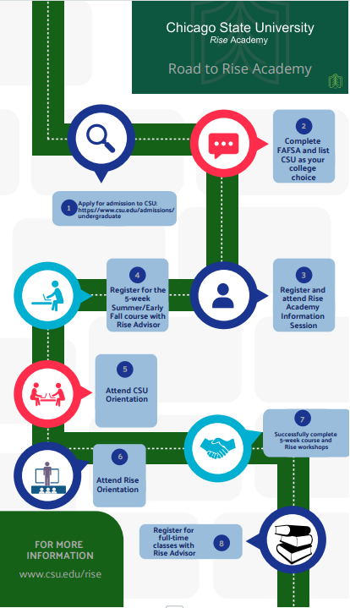
Rise Roadmap
Notes:
The student will earn 3 college credits before the fall semester even starts.
Students will get to know their professors and freshmen classmates.
Discover how different college majors lead to career paths and which is right for you.
Explore the Chicago State campus and student resources

Slide 16
The Impact of Rise Academy

Slide 17
Rise Academy Partners
Mentorship Program Rise Partners
Relativity: Students who may have expressed interest in computer science and legal studies
Wintrust: (Finance, Accounting, and Business majors) as part of the CSU Champions mentoring program.

Slide 18
Rise Academy Partners
Non-Mentorship Rise Partners
Dempsey Travis
Rivers Casino
AT&T(STEM-focused majors):
Grant excerpt: "To support eight STEM Majors with $6,250 scholarships to participate in Rise Academy, a student success initiative that will ensure these students are prepared to fill the openings in the retiring tech workforce as well as new technology companies who are looking for employees to help them grow."

Slide 19
Questions?

